Slide 1
Impact of Significant Events on Individuals & Communities

Slide 2
From your syllabus
Positive responses –
Resilience and Post Traumatic Growth
Negative responses –
Post Traumatic Stress Disorder
Event characteristics contributing to stress predictability; controllability; experience of threat or loss

Slide 3
Significant Events
Large scale events that affect more than an individual
September 11 United States Terrorist Attacks
The Great Depression
The Yarloop Bushfire
Women in the Workforce
Homosexual Marriage
Trauma
Natural Disasters – Earthquakes, Tsunami
Olympic Games
Vaccination creation
New medical treatments

Slide 4
Event characteristics contributing to stress
Predictability;
Controllability;
Experience of threat or loss

Slide 5
Predictability
Whilst some events are stressful, even if they are predictable, it is usually the case that unpredictable events are more stressful and have a longer lasting impact.

Slide 6
Controllability
Having no control over events is a major source of stress reported from victims of terrorist attacks and long term residents of refugee camps.

Slide 7
Experience of Threat or Loss
Whether we experience threat or loss also contributes to the stress of the situation.
Media inclusive of social media can make some events appear more personal than they are, and can exacerbate this experience.

Slide 8
Empirical Research
The psychological difference between temporally predictable and unpredictable stressful events: Evidence for information control theories. Katz &Wykes
Lack of Control & Physiological Measures Geer and Maisel (1972)
The Relationship of Hardiness, Gender, and Stress to Health Outcomes in Adolescents. Kobasa 1977

Slide 9
Resilience
Most commonly, the term resilience has come to mean an individual’s ability to overcome adversity and continue his or her normal development.

Slide 10

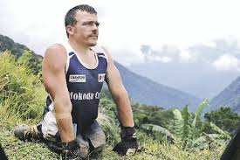
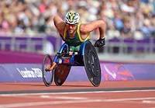


Examples
Kurt Fearnley
Nick Vujicic
Malala Yousafzai

Slide 11
Resilience is
“In the context of exposure to significant adversity, resilience is both the capacity of individuals to navigate their way to the psychological, social, cultural, and physical resources that sustain their well-being, and their capacity individually and collectively to negotiate for these resources to be provided in culturally meaningful ways.”
Dr. Michael Unger

Slide 12
A Multidimensional Model of Resilience
General Factors
assertiveness
ability to solve problems
self-efficacy
ability to live with uncertainty
self-awareness
a positive outlook
empathy for others
having goals and aspirations
ability to maintain a balance between independence and dependence on others
appropriate use of or abstinence from substances like alcohol and drugs
a sense of humour
a sense of duty (to others or self, depending on the culture)

Slide 13
Relationship Factors
Parenting that meets the child’s needs
Appropriate emotional expression and parental monitoring within the family
Social competence
The presence of a positive mentor and role models
Meaningful relationships with others at school, home, and perceived social support
Peer group acceptance

Slide 14
Community Factors
Opportunities for age-appropriate work
Avoidance of exposure to violence in one’s family, community, and with peers
Government provision for children’s safety, recreation, housing, and jobs when they are at the appropriate age to work
Meaningful rites of passage with an appropriate amount of risk
Tolerance of high-risk and problem behaviour
Safety and security
Perceived social equity
Access to school and education, information and learning resources

Slide 15
Cultural Factors
Affiliation with a religious organisation
Tolerance for different ideologies and beliefs
Adequate management of cultural dislocation and a change or shift in values
Self-betterment
Having a life philosophy
Cultural and/or spiritual identification
Being culturally grounded by knowing where you come from and being part of a cultural tradition that is expressed through daily activities

Slide 16
Physical Ecology Factors
Access to a healthy environment
Security in one’s community
Access to recreational spaces
Sustainable resources
Ecological diversity

Slide 17
Stress
Stress refers to a challenge to a person’s capacity to adapt to inner and outer demands.
Stressful experiences typically produce physiological and emotional arousal.
Stressful experiences typically elicit cognitive and behavioural efforts to cope with the stress.

Slide 18
3 Types of Stress:
Harm or loss - when a person loses a loved one or something of value (e.g., job)
Threat - perceived anticipated harm (e.g., expecting to lose your job)
Challenge - opportunities for growth that may nonetheless be fraught with disruption and uncertainty (e.g., getting married, starting university, starting a new job). These are positive events but are still perceived as stressful as they involve change and adjustment.

Slide 19
What is a potentially traumatic event?
Potentially traumatic events are powerful and upsetting incidents that intrude into daily life. They are usually defined as experiences which are life threatening, or where there is a significant threat to one's physical or psychological wellbeing.
The same event may have little impact on one person but cause severe distress in another individual. The impact that an event has may be related to the person's mental and physical health, level of available support at the time of the event, and past experience and coping skills.
Situations and events that can lead a person to experience psychological trauma include:
Acts of violence such as an armed robbery, war or terrorism
Natural disasters such as bushfire, earthquake or floods
Interpersonal violence such as rape, abuse, or loss of a family member/friend
Involvement in a serious motor vehicle or workplace accident
Bullying
Other less severe but still stressful situations can also trigger traumatic reactions in some people.

Slide 20
Post Traumatic Stress Disorder (PTSD)
Post-traumatic stress disorder (PTSD), also called post-traumatic stress syndrome, emotional condition that sometimes follows a traumatic event, particularly an event that involves actual or threatened death or serious bodily injury to oneself or others and that creates intense feelings of fear, helplessness, or horror.

Slide 21
What are the symptoms of psychological trauma?
Physical | Excessive alertness, on the look-out for signs of danger Easily startled Fatigue/exhaustion Disturbed sleep General aches and pains
Cognitive | Intrusive thoughts and memories of the event Visual images of the event Nightmares Poor concentration and memory Disorientation Confusion
Behavioural | Avoidance of places or activities that are reminders of the event Social withdrawal and isolation Loss of interest in normal activities
Emotional | Fear Numbness and detachment Depression Guilt Anger and irritability Anxiety and panic

Slide 22
Symptoms of PTSD
Symptoms of PTSD include the re-experiencing of the trauma either through upsetting thoughts or memories or, in extreme cases, through a flashback in which the trauma is relived at full emotional intensity.
People with PTSD often report a general feeling of emotional numbness, experience increased anxiety and vigilance, and avoid reminders of the trauma, such as specific situations, thoughts, and feelings.
It is normal to experience such reactions to some extent following trauma, and they are not considered symptoms of PTSD unless they last for at least one month or have a delayed onset.
People with PTSD can also suffer from other psychological problems, particularly depression, anxiety, and drug abuse.

Slide 23
PTSD Specifics
Re-experiencing the trauma in the form of intrusive memories, nightmares or flashbacks
Avoidance of reminders and numbing of emotional responsiveness
Hyperarousal - feeling jumpy and on edge.
PTSD is very distressing and can lead to serious ongoing problems with social relationships and the ability to work or carry out normal daily activities. PTSD usually requires professional assistance as these problems tend not to resolve by themselves with the passage of time.
Depression, anxiety disorders (such as panic, phobias, and general anxiety) and alcohol or drug disorders may also develop following trauma in some people. These conditions may occur with, or in the absence of, PTSD.

Slide 24
Risk Factors and Resilience Factors for PTSD
Some factors that increase risk for PTSD include:
Living through dangerous events and traumas
Getting hurt
Seeing another person hurt, or seeing a dead body
Childhood trauma
Feeling horror, helplessness, or extreme fear
Having little or no social support after the event
Dealing with extra stress after the event, such as loss of a loved one, pain and injury, or loss of a job or home
Having a history of mental illness or substance abuse

Slide 25
Treatment of PTSD
Medications
Psychotherapy
Cognitive Behaviour Therapy
Exercise and sleep therapy

Slide 26
POST TRAUMATIC GROWTH (PTG)

Slide 27
Post Traumatic Growth (PTG)
Traumatic experiences can also provide a catalyst for significant positive life changes, most commonly referred to as post-traumatic growth (PTG).
PTG, coined by Tedeschi & Calhoun in 1995, refers to positive changes in a person’s life that can occur because of a traumatic response to an experience.
PTG is not seen as the opposite end of a mental health outcome continuum; ongoing distress can co-occur with growth.
Neither is PTG an automatic by-product of experiencing trauma or an inevitable outcome.

Slide 28
PTG Continued
Experiencing a traumatic event, people often report three ways in which their psychological functioning increases:
1. Relationships are enhanced in some way. For example, people describe that they come to value their friends and family more, feel an increased sense of compassion for others and a longing for more intimate relationships.
2. People change their views of themselves in some way. For example, developing in wisdom, personal strength and gratitude, perhaps coupled with a greater acceptance of their vulnerabilities and limitations.
3. People describe changes in their life philosophy. For example, finding a fresh appreciation for each new day and re-evaluating their understanding of what really matters in life, becoming less materialistic and more able to live in the present.

Slide 29
Post Traumatic Growth (PTG)
PTG can occur as a result of cognitively engaging in the traumatic material, that aim to change the way a person sees the impact of the experience, through disclosing about the experience by sharing (for example, talking, creating art and playing music), and having appropriate support where expression of difficulties is accepted and validated. PTG involves the creation of a new narrative and in doing so creates new neural pathways.

Slide 30
Post Traumatic Growth tends to occur in five general areas
1. Sometimes people who must face major life crises develop a sense that new opportunities have emerged from the struggle, opening up possibilities that were not present before.
2. A second area is a change in relationships with others. Some people experience closer relationships with some specific people, and they can also experience an increased sense of connection to others who suffer.
3. A third area of possible change is an increased sense of one’s own strength – “if I lived through that, I can face anything”.
4. A fourth aspect of posttraumatic growth experienced by some people is a greater appreciation for life in general.
5. The fifth area involves the spiritual or religious domain. Some individuals experience a deepening of their spiritual lives, however, this deepening can also involve a significant change in one’s belief system.

Slide 31
Empirical Evidence
There are many examples that attest to this phenomenon in recent research and literature. For example, PTG has been reported by sexual assault survivors (Shakespeare-Finch & de Dassel, 2009), combat veterans (Tedeschi & McNally, 2011), students (Tedeschi & Calhoun, 1996), emergency service workers (Shakespeare-Finch, Gow, & Smith, 2005) and cancer survivors (Sliva, Moreira, & Canavarro, 2012).
Scientific evidence of PTG has been found across many cultures (Weiss & Berger, 2010) and is a more common post-trauma outcome than ongoing psychopathology

Slide 32
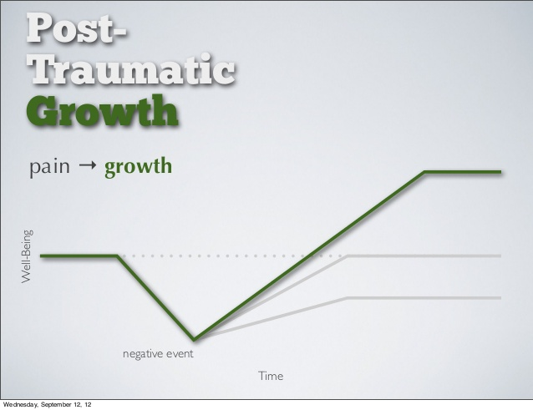

Slide 33
Post Traumatic Growth Inventory
The development of the Post traumatic Growth Inventory, an instrument for assessing positive outcomes reported by persons who have experienced traumatic events, is described.
This 21-item scale includes factors of New Possibilities, Relating to Others, Personal Strength, Spiritual Change, and Appreciation of Life.
Women tend to report more benefits than do men, and persons who have experienced traumatic events report more positive change than do persons who have not experienced extraordinary events.
The Posttraumatic Growth Inventory is modestly related to optimism and extraversion. The scale appears to have utility in determining how successful individuals, coping with the aftermath of trauma, are in reconstructing or strengthening their perceptions of self, others, and the meaning of events.

Slide 34
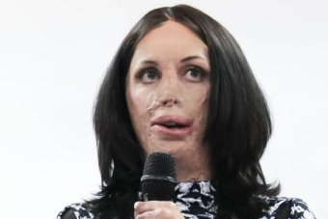


Examples
Turia Pitt
Ahn Do
Sophie Delezio

Slide 35
Research
Headstrong Project www.getheadstrong.org
Australian Veterans on Insight
Why is Vanuatu the most vulnerable place in the world?

Slide 36
More Links…
Skidrow Stories
http://skidrowstories.com/category/people-of-skid-row/
ABC Story – What it is like to witness a shooting and live with memories of traumatic events
http://www.abc.net.au/news/2016-08-09/what-it's-like-to-experience-trauma-and-ptsd/7710696
Community Resilience
https://ourworld.unu.edu/en/deep-roots-of-community-resilience

